Slide 1

MIS 547
Cloud Computing

Slide 2

Admin
Assignment 6 Due Monday at 11:59pm
01
Group project mid-semester update due 10/24
03
04
Quiz 6 on Thursday- due Sunday 11:59pm
02

Slide 3
AGENDA
What’s covered in this lecture:
Agenda
Microservices
Microservices Introduction
Microservice migrations

Slide 4
Lecture 12 Microservices

Slide 5
What are Microservices
Small, independent processes that communicate with each other to form complex applications
Small building blocks, decoupled and focused on doing a small task
Modular approach to system building
Over the last 10 years, this has become the dominant approach to building applications.

Slide 6
Monoliths
How we used to (And still) do things

Slide 7

Monolith
All components of the application are part of a single unit
User interface, web server, database
Everything developed, deployed, scaled as one unit
One language, one stack, one runtime
Must coordinate across teams to make sure they don’t impact each others work
Rebuild whole application and deploy when one team makes an update

Slide 8
Monolith challenges
Requires high coordination between teams
You can only scale the entire app, instead of a specific service
Higher infrastructure costs, less flexibility
Dependency difficulties
Release process takes longer
Changes in any part or any feature you need to test and build the whole app to deploy changes

Slide 9
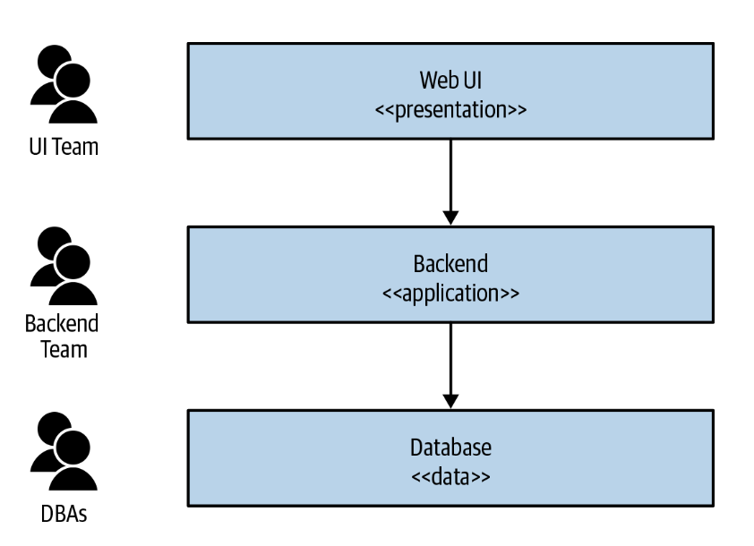
Monolith Challenges
Three-tier architecture:
UI
Backend (monolithic application)
Database
Generally divided by technical capabilities
E.g., web developers, DBAs, etc.
What if we want to make a change to the Web UI to add functionality?
Each piece of the architecture must be updated and redeployed

Slide 10
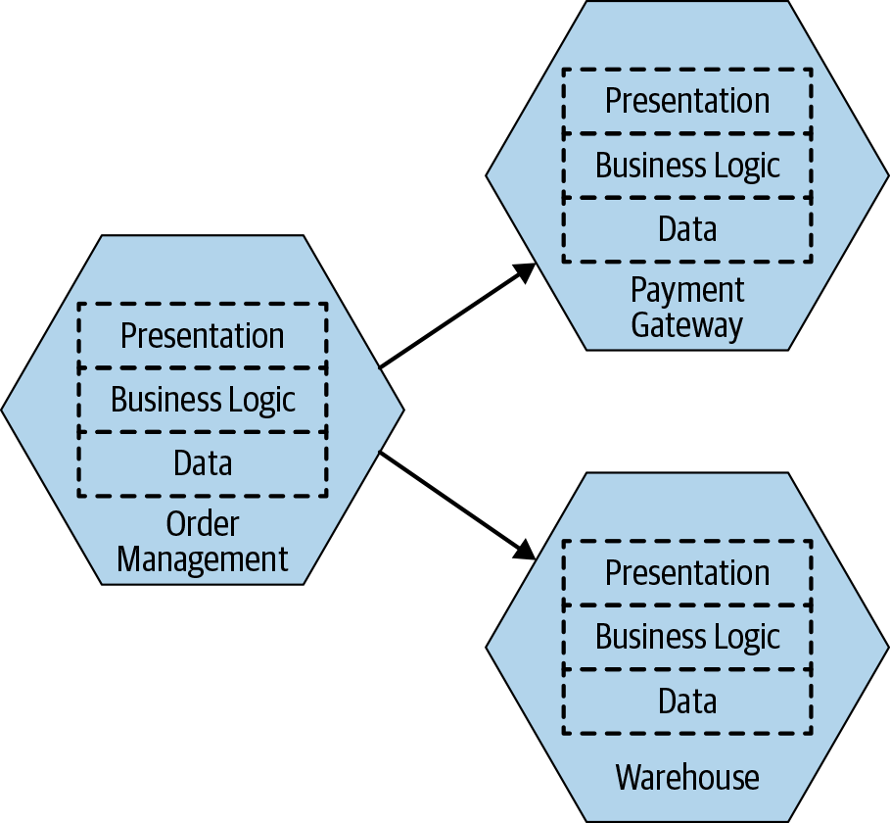
Breaking up the Monolith into Microservices
Services are end-to-end slices of business functionality

Slide 11
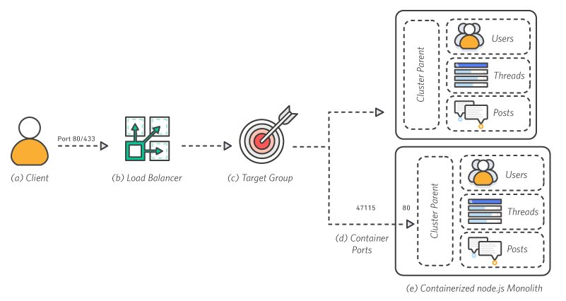
Monolith Architecture
(a) The client makes a request over port 80 or 443 to the load balancer
(b)- The load balancer distributes requests across all available ports
(c)- Target Groups- Instances are registered in the application’s target group
(d)- Each container runs a single application process which binds the cluster parent to port 80
(e)- The cluster parent is responsible for distributing traffic Each container has all the same features as the rest of the containers.
Source: AWS

Slide 12
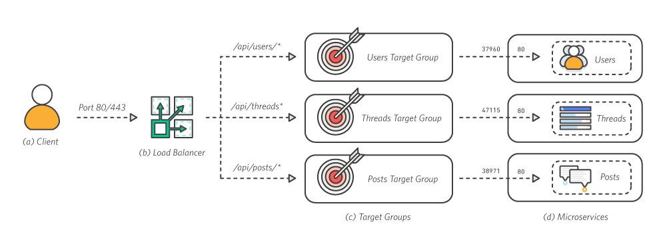
Microservice Architecture
(a) The client makes a request over port 80 or 443 to the load balancer
(b) The load balancer routes traffic to the correct service. The ALB inspects the client request and uses the routing rules to direct the request to an instance and port for the target group matching the rule
(c) Each service has a target group that keeps track of the instances and ports of each container running for that service.
(d) Each service is deployed into a container across an EC2 cluster. Each container only handles a single feature
Source: AWS

Slide 13
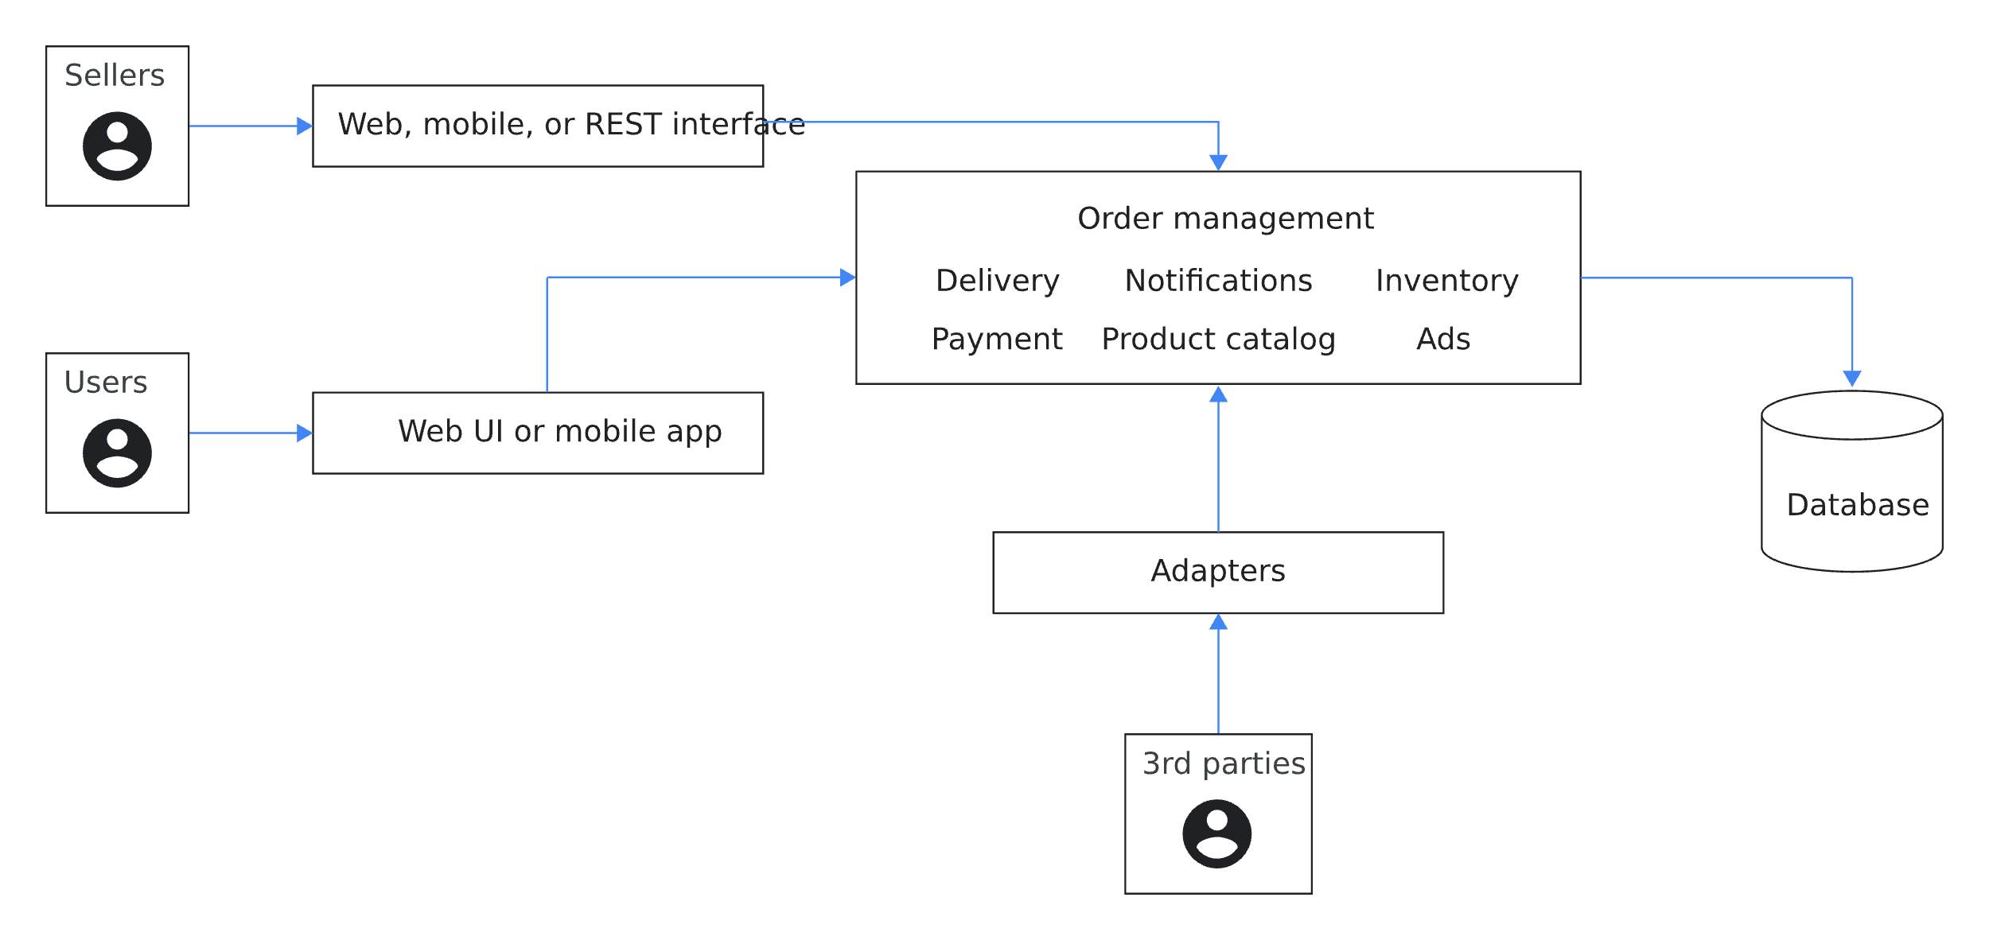
Monolithic architecture
Source: GCP

Slide 14
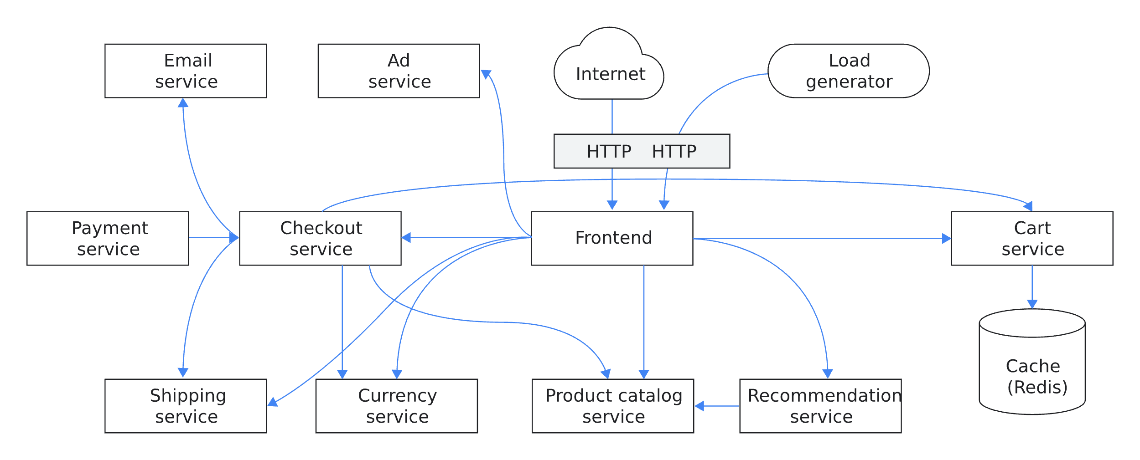
Microservice Architecture
Source: GCP

Slide 15
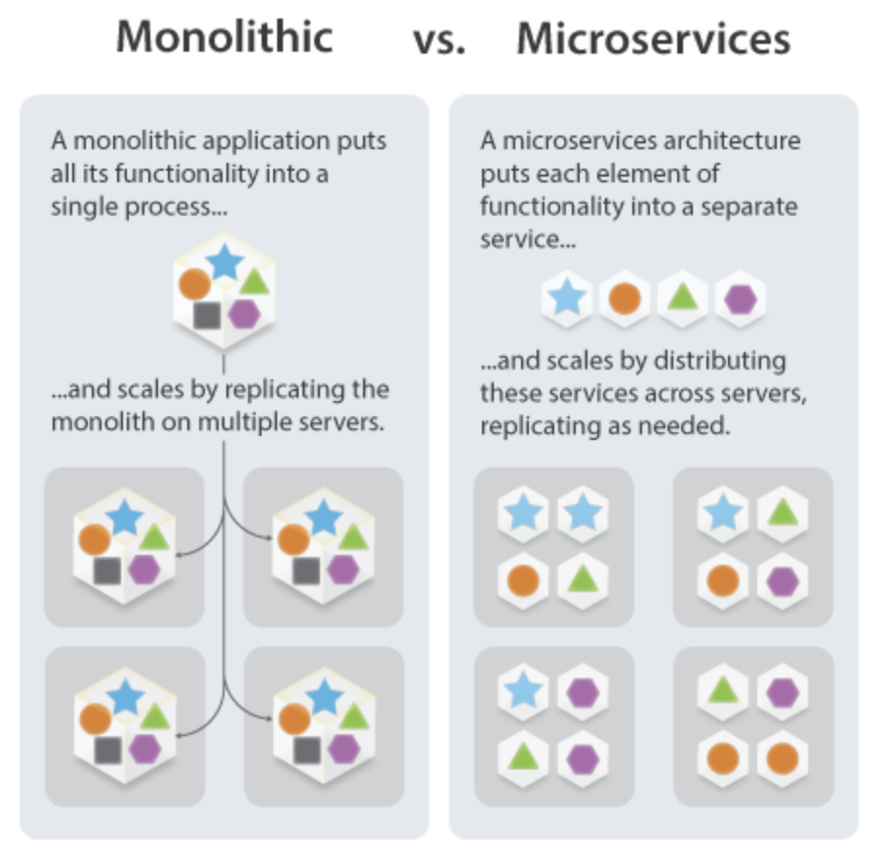
Microservices
Source: The Linux Foundation

Slide 16
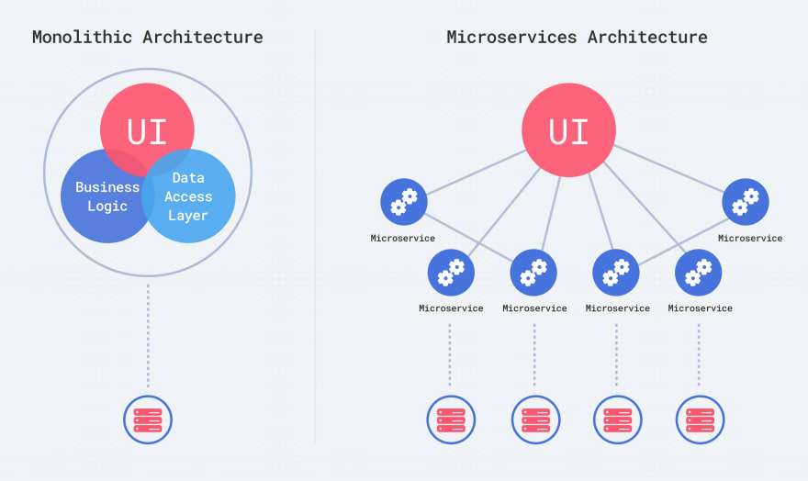
Microservices
Split application into smaller, independent services
Micro applications make up one big application
Questions:
How to break down the application?
What code goes where?
How many microservices do we create?
How big/small should they be?
How do they talk to each other?

Slide 17
Microservice Key Requirements
Independently releasable
We can make changes to one microservice without having to deploy any other service
Modelled around a business domain
Instead of separating services according to their technical functionality, we create services according to a business requirement
Own their own state
Don’t share databases unless you really need to
Migrate incrementally
More microservices == more complexity (you’ll need to be able to handle this!)

Slide 18
Microservices Best Practices
Split based on business functionalities, not technical functionalities
Separation of concerns
Self-contained and independent of each other
Developed, deployed, and scaled separately
Loose coupling
Release cycle completely independent

Slide 19
Migrating to Microservices
Start carving out services from a monolith
Split the monolith based on business logic, front-end (presentation), and data access.
Create a local database for individual services
If you need new functionality while refactoring the monolith, create a microservice instead of adding more code to the monolith.
If services need data from other services, implement an event-driven communication between these services.

Slide 20
Microservice Benefits
No language or technology lock-in.
Each service can use independent languages, technologies, frameworks, etc.
Deploy and manage services independently
Each service can be updated and scaled independently
If one service fails → avoid cascading failures
Reuse code
Modular code already written for one service can be used for another
Continuous delivery
Components can be deployed across multiple servers or even multiple data centers

Slide 21
Most Important advantage of Microservices
Develop service with different languages, stacks, and teams

Slide 22
Monorepos and polyrepos
How to structure your microservice code

Slide 23
MonoRepo
Single repository
1 git repository that contains many projects
Folders for each service
All the code are in respective folders
Makes code management and development easier
Changes can be tracked together, tested together and released together
Can put Kubernetes configuration, Dockerfiles, compose.yaml all the the same folder so other services can use them

Slide 24
Monorepo Challenges
Easy to break criteria of no tight coupling
Tightly coupled logic
Big source code
Git interactions become slow
One CI/CD pipeline for one project
Have to add additional logic necessary to make sure you only build and deploy changes that have changed
One main branch
If main is broken, other services and pipelines will break as well

Slide 25
PolyRepo
For each service, we create a separate git project
Clone and work on them separately
Still part of a bigger application
Can create independent secrets and other variables unique to each service
CI/CD pipeline
Own pipeline for each repository
No extra logic needed

Slide 26
Polyrepo Downsides
Cross-cutting changes are more difficult
Changes spread across projects must be submitted as separate merge requests instead of a single atomic MR
Switching between projects is tedious
Searching, testing, debugging is more difficult
Sharing resources is more difficult

Slide 27
General Best Practices
Small project: stick to monorepo, save overhead
Separate teams for each service: polyrepo is a better option

Slide 28
Microservice Challenges

Slide 29
Microservice Challenges
Choosing the right functionality and scope for a service
Deployment requires distributed environments
End-to-end testing can be challenging (testing all microservices together)
Inter-service communication can be costly
Managing databases and consistency across databases
Monitoring and logging
Elastic, Sysdig, Datadog help monitor, log, and debug microservices

Slide 30
Challenges of microservices
Communication
How do services know how to talk to each other?
Security
Communication inside cluster not secured
Every service inside the cluster can talk to any other service
If an attacker gets inside the cluster, no additional security, they can access any service
Additional config required
Retry logic
Metrics and tracing logic (how the services are performing)

Slide 31
Microservice Communication
….How do all these services communicate?

Slide 32
Communication between microservices
Microservices talk to each other through API calls
Each service has its own API
Services talk through http requests through API endpoints
Synchronous communication (send request, wait for response)
Asynchronous communication (message broker with asynchronous communication)
A service sends message to broker; message broker forwards to destination service
Third way: Service Mesh
Helper service which takes over communication logic

Slide 33
Discussion: How might microservices and cloud computing relate to one another?

Slide 34
Industry Trends And Stories
See video interview with Adam Shamblin, Staff Product Security Engineer at DigitalOcean
Link available in D2L

Slide 35
Land Acknowledgement Statement
We respectfully acknowledge the University of Arizona is on the land and territories of Indigenous peoples. Today, Arizona is home to 22 federally-recognized tribes, with Tucson being home to the O’odham and the Yacqui. Committed to diversity and inclusion, the University strives to build sustainable relationships with sovereign Native Nations and Indigenous communities through education offerings, partnerships, and community service.

